Slide 1
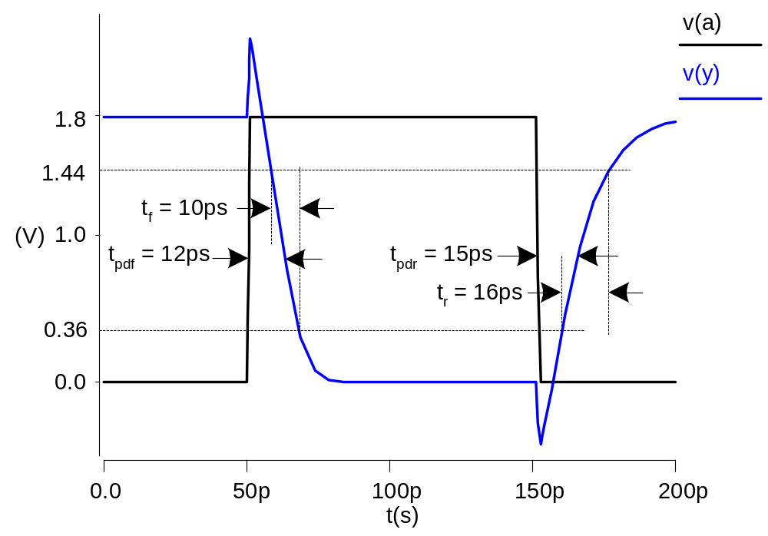
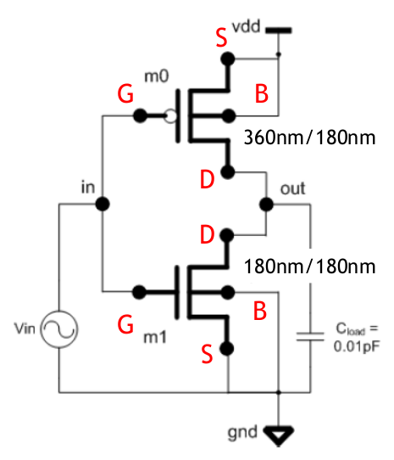
Transient Results
Unloaded inverter
  Overshoot
  Very fast
  edges
V(in)
V(out)
Slide <number>

Slide 2
INV Circuit SPICE Deck
**----------------------------------------------------------
* Inverter SPICE deck
**----------------------------------------------------------
* Parameters and models
**----------------------------------------------------------
.include mosistsmc180.sp.tx
.options post list scale=1n
**----------------------------------------------------------
* Simulation netlist
**----------------------------------------------------------
Vdd Vdd gnd 1.8V
Vin in 0 PULSE 0 1.8V 0.5ns 0.1ns 0.1ns 10ns 20ns
m0 out in Vdd Vdd PMOS W=360 L=180
m1 out in 0 0 NMOS W=180 L=180
cload out 0 0.01pF
Slide <number>

Slide 3
INV Circuit SPICE Deck…contd.
**----------------------------------------------------------
* Stimulus
**----------------------------------------------------------
.tran 1ns 40ns
.measure tran tr TRIG v(out) val=0.36 RISE=1 TARG v(out) val=1.44 RISE=1
.measure tran tpdr TRIG v(in) val=0.9 FALL=1 TARG v(out) val=0.9 RISE=1
.measure tran tpdf TRIG v(in) val=0.9 RISE=1 TARG v(out) val=0.9 FALL=1
*** Output statements
.plot V(in) V(out)
.end
Slide <number>

